Slide 1
Project Base Learning
Comunicação de Dados e Redes ||
Segurança de Redes E Sistemas
Bernardo Magalhães
João Aragão

Slide 2
Introdução
O Prject Base Learning tem como objetivo que os alunos da Unidade Curricular Comunicação de Dados e Redes || e Segurança de Redes e Sistemas, tenham uma noção mais próxima da realidade no que diz respeito tanto à questão da segurança como na questão de todo o planeamento e implementação de uma rede.
O software utilizado para a realização do trebalho foi:
Cisco Packet Tracer
Microsoft Excel
Microsoft PowerPoint
Microsoft Visio
GitHub

Slide 3
Conteúdos
01
04
Topologia
Interfaces Lógicas
02
05
Ligação Física
VTP
03
06
Subnetting
STP

Slide 4
Conteúdos
07
10
Atribuição de portas ás VLAN’s
XXX
08
11
DHCP
XXX
09
12
XXX
XXX

Slide 5
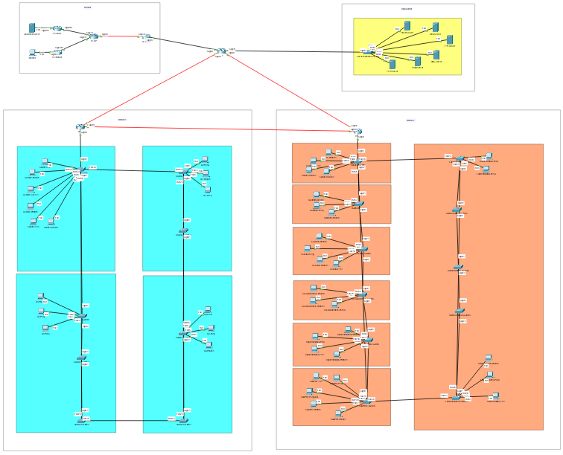
Topologia Lógica

Slide 6
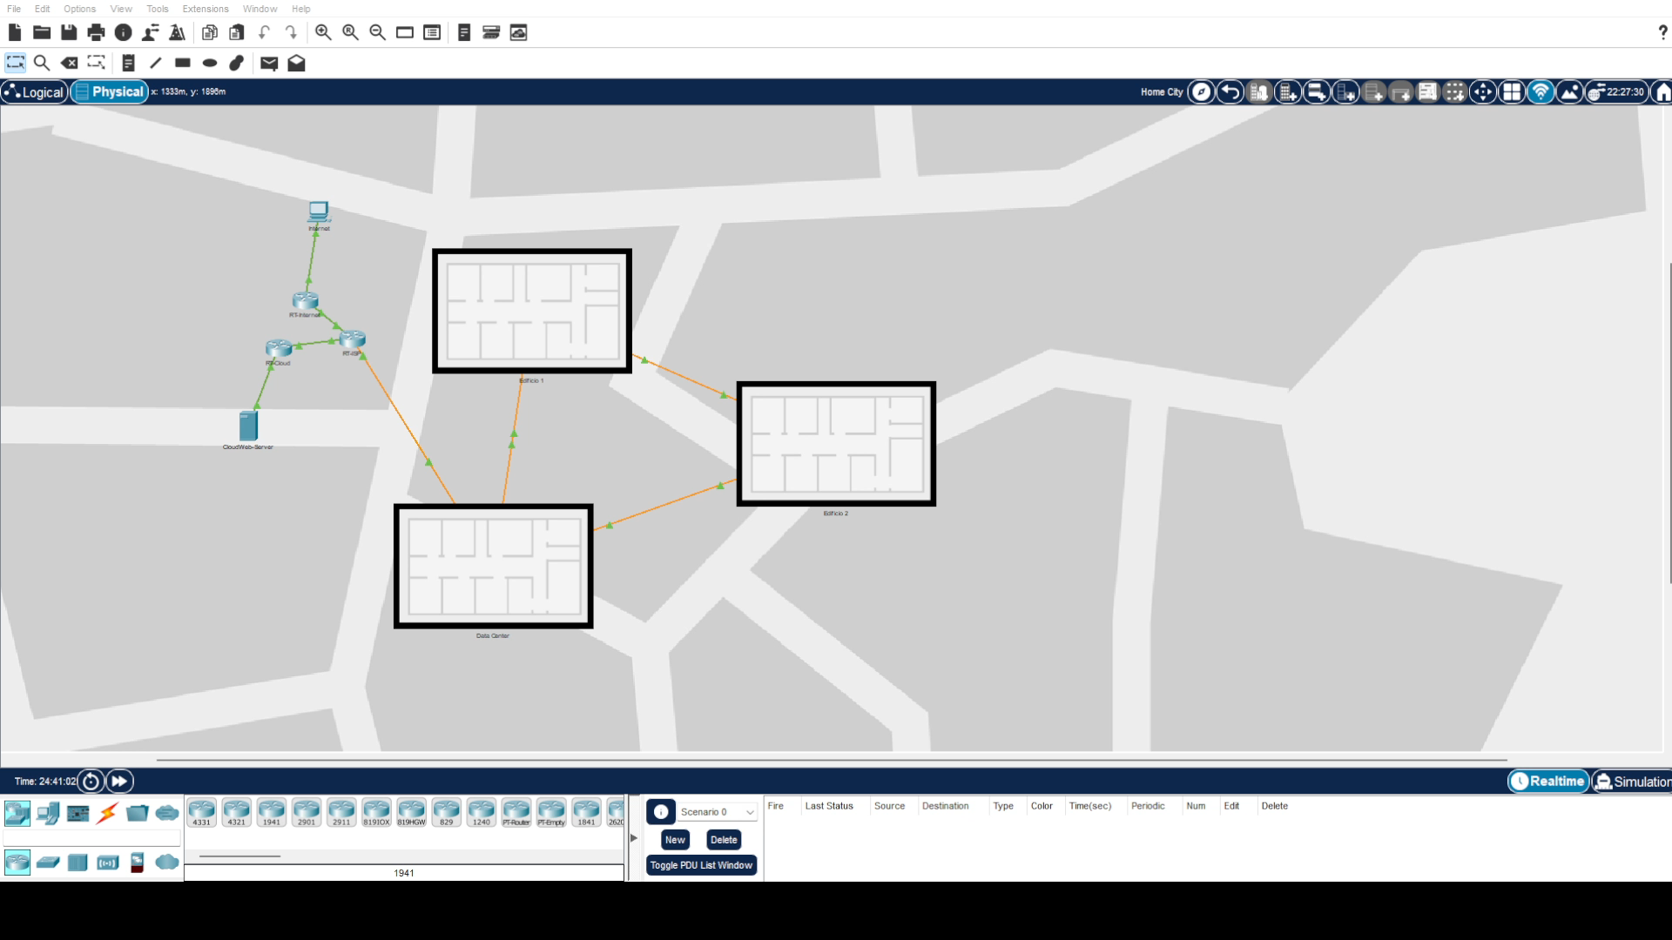
Ligação Física (Edifício 1)

Slide 7
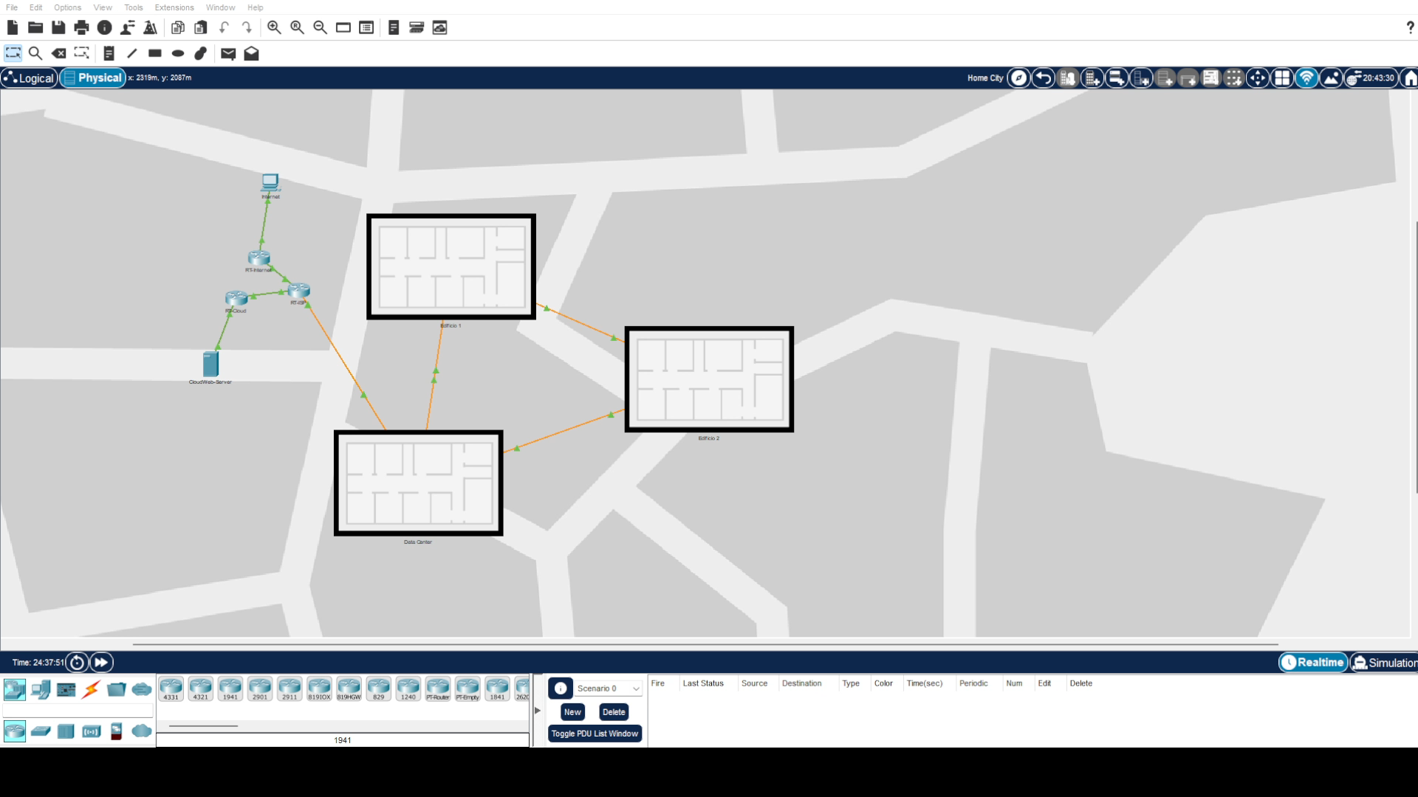
Ligação Física (Edifício 2)

Slide 8
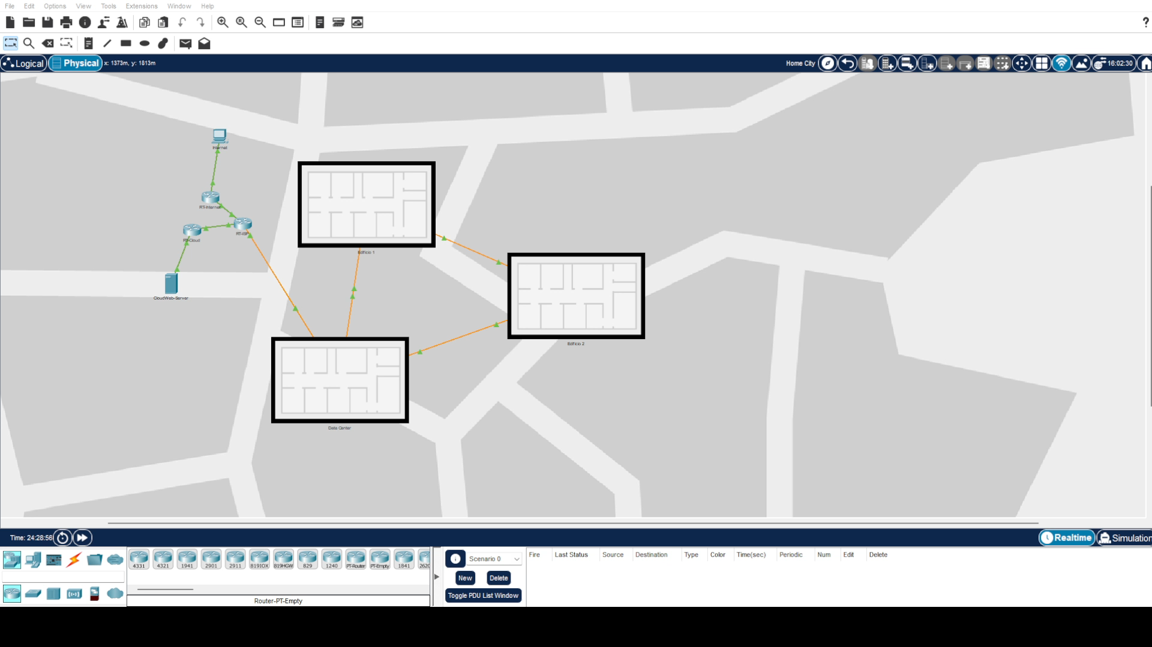
Ligação Física (Data Center)

Slide 9
Subnetting
Edifício 1
Nome VLAN | NºIP's | 192.168.0.0 /23
Alunos | 130+3 | 192.168.0.0 - 255 /24
Sistemas Auxiliares | 12+3 | 192.168.1.0 - 15 /28
Gestão de Equipamentos de Rede | 9+3 | 192.168.1.16 - 31 /28
Convidados | 5+3 | 192.168.1.32 - 39 /29
Voip | 4+3 | 192.168.1.40 - 47 /29
Professores | 3+3 | 192.168.1.48 - 55 /29
Total | 181
DataCenter
Nome VLAN | NºIP's | 192.168.9.0 /24
Servidores | 6+3 | 192.168.9.0 - 15 /28
Gestão de Equipamentos de Rede | 3+3 | 192.168.9.16 - 23 /29
Total | 15

Slide 10
Subnetting
Edifício 2
Nome VLAN | NºIP's | 192.168.2.0 /23
Alunos | 100+3 | 192.168.2.0 - 127 /25
Sistemas Auxiliares | 44+3 | 192.168.3.0 - 63 /26
Voip | 29+3 | 192.168.3.64 - 95 /27
Departamento de Serviços Academicos | 10+3 | 192.168.3.96 - 111 /28
Conselho de Gestão | 7+3 | 192.168.3.112 - 127 /28
Gestão de Equipamentos de Rede | 12+3 | 192.168.3.128 - 143 /28
Professores | 8+3 | 192.168.3.144 - 159 /28
Departamento de Informática | 4+3 | 192.168.3.160 - 167 /29
Convidados | 1+3 | 192.168.3.168 - 171 /30
Total | 242
Interligação entre Routers
Nome VLAN | IP
RT-Internet<->RT-ISP | 10.10.10.0 - 3/30
RT-Cloud<->RT-ISP | 10.10.10.4 - 7 /30
RT-ISP<->RT-WAN | 10.10.10.8 - 11 /30
RT-WAN<->RT-1 | 10.10.10.12 - 15 /30
RT-1<->RT-2 | 10.10.10.16 - 19 /30
RT-1<->RT-3 | 10.10.10.20 - 23 /30
RT-2<->RT-3 | 10.10.10.24 - 27 /30

Slide 11
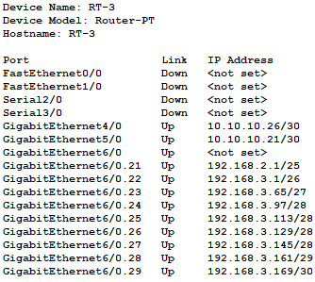
Interfaces Lógicas

Slide 12
VTP
Investigação
Criação dos Servidores
Início
Fim
Implementação
Configuração dos Clientes

Slide 13
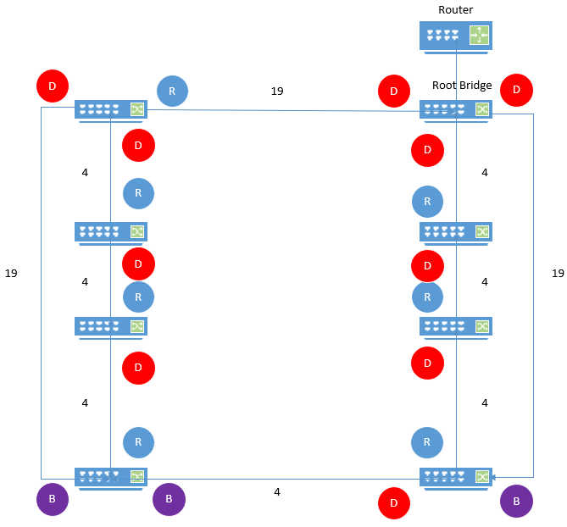
Spanning Tree Protocol (STP)
Edifício 1

Slide 14
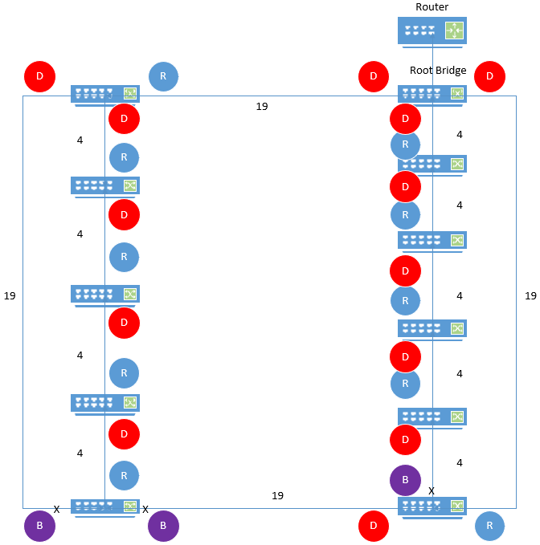
Spanning Tree Protocol (STP)
Edifício 2

Slide 15
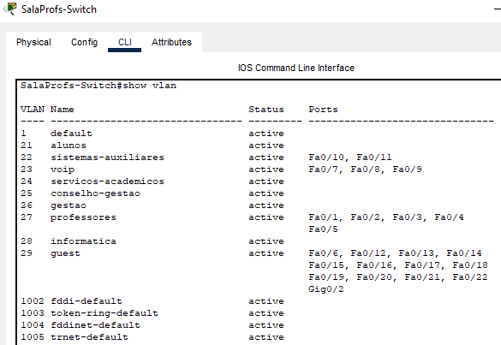
Atribuição de Portas ás VLAN’s

Slide 16
Dynamic Host Configuration Protocol (DHCP)
MARS
VENUS
MERCURY
Mercury is the closest planet to the Sun and the smallest one in our Solar System
Despite being red, Mars is a cold place, not hot. It’s full of iron oxide dust
Venus has a beautiful name and is the second planet from the Sun

Slide 17
OUR COMPANY
GOSTUDIO
Mercury is the closest planet to the Sun and the smallest one in the Solar System—it’s only a bit larger than our Moon. The planet’s name has nothing to do with the liquid metal since it was named after the Roman messenger god, Mercury.

Slide 18
WHAT WE ARE WORKING ON
SECURE
ACCESSIBLE
FAST AND RELIABLE
Mercury is the closest planet to the Sun
Despite being red, Mars is a cold place, not hot
Neptune is the farthest planet from the Sun

Slide 19
ABOUT THE PROJECT
O Prject Base Learning tem como objetivo que os alunos da Unidade Curricular Comunicação de Dados e Redes || e Segurança de Redes e Sistemas, tenham uma noção mais próxima da realidade no que diz respeito tanto à questão da segurança como na questão de todo o planeamento e implementação de uma rede. O software utilizado para a realização do trebalho foi:

Slide 20
—SOMEONE FAMOUS
“This is a quote. Words full of wisdom that someone important said and can make the reader get inspired.”

Slide 21
FUTURE
BRANDING
POSITIONING
ADAPTABILITY

Slide 22
MAJOR REQUIREMENTS
IMAGES
USER EXPERIENCE
INFORMATION
Despite being red, Mars is a cold place, not hot. It’s full of iron oxide dust
Venus has a beautiful name and is the second planet from the Sun
Mercury is the closest planet to the Sun and the smallest in our Solar System

Slide 23
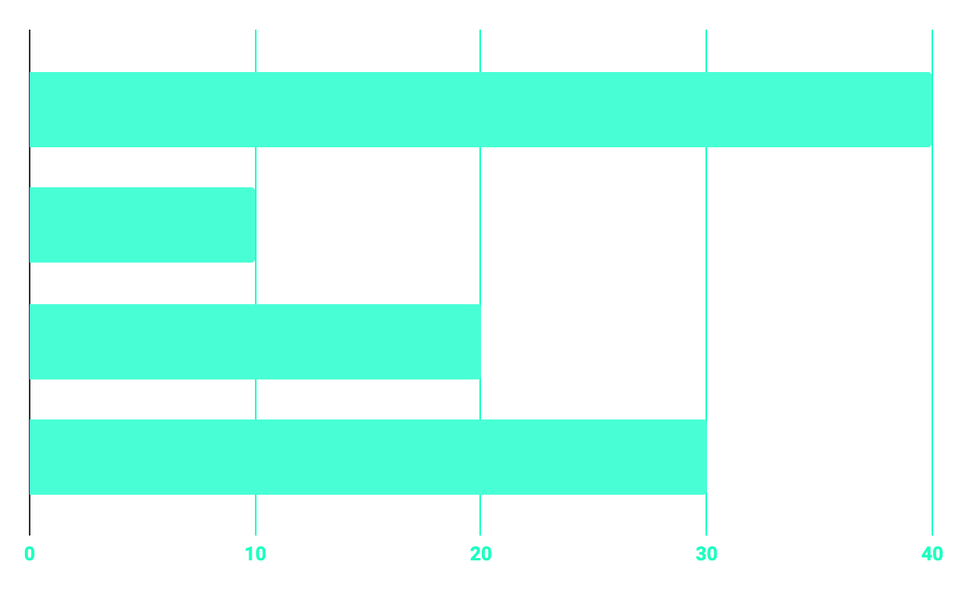
BUDGET
40%
20%
PROGRAMMING
10%
30%
DATABASE
WEB DESIGN
UX RESEARCH

Slide 24
OUR GOALS
EXPANSION
POSITIONING
USABILITY
Neptune is the fourth-largest planet in our Solar System
Venus has a beautiful name and is the second planet from the Sun
Despite being red, Mars is a cold place, not hot. It’s full of iron oxide dust

Slide 25
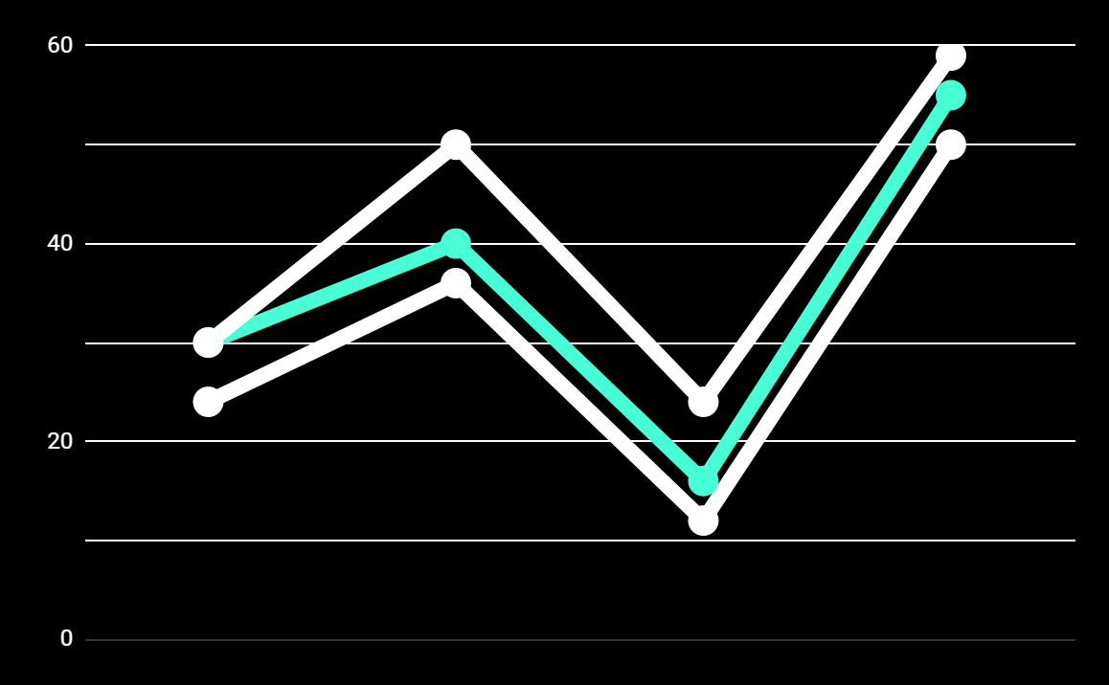
PREDICTED RESULTS
CONVERSIONS NEXT YEAR
+20%
MONTHLY VISITS
+33%
CONVERSION RATE
+40%
ANNUAL ORDERS

Slide 26
SNEAK PEEK
HEADER
TEXT
SLIDER
ICONS

Slide 27
PROJECT STAGES
STEP 2
STEP 1
STEP 3
Venus has a beautiful name and is the second planet from the Sun
Despite being red, Mars is a cold place, not hot. It’s full of iron oxide dust
Saturn is a gas giant, composed mostly of hydrogen and helium

Slide 28
OUR PARTNERS
MARS
VENUS
MERCURY
Mercury is the closest planet to the Sun and the smallest one in our Solar System
Despite being red, Mars is a cold place, not hot. It’s full of iron oxide dust
Venus has a beautiful name and is the second planet from the Sun

Slide 29
THANKS!
Does anyone have any question?
addyouremail@freepik.com
+91 620 421 838
yourcompany.com

Slide 30
CREDITS
This is where you give credit to the ones who are part of this project.
Presentation template by Slidesgo
Icons by Flaticon
Infographics by Freepik
Images created by Freepik
Author introduction slide photo created by Freepik
Text & Image slide photo created by Freepik

Slide 31
RESOURCES
Did you like the resources on this template? Get them for free at our other websites.
PHOTOS
Young businessman with hands in his pocket talking on mobile phone
Smiling ethnic woman with gray laptop
Smiling young man busy in texting message to someone
VECTORS
Flat computer engineering concept
Circuit of user experience
Timeline infographic

Slide 32
Instructions for use
In order to use this template, you must credit Slidesgo by keeping the Thanks slide.
You are allowed to:
- Modify this template.
- Use it for both personal and commercial projects.
You are not allowed to:
- Sublicense, sell or rent any of Slidesgo Content (or a modified version of Slidesgo Content).
- Distribute Slidesgo Content unless it has been expressly authorized by Slidesgo.
- Include Slidesgo Content in an online or offline database or file.
- Offer Slidesgo templates (or modified versions of Slidesgo templates) for download.
- Acquire the copyright of Slidesgo Content.
For more information about editing slides, please read our FAQs:
https://slidesgo.com/faqs

Slide 33
Fonts & colors used
This presentation has been made using the following fonts:
Roboto
(https://fonts.google.com/specimen/Roboto+bold)
Roboto
(https://fonts.google.com/specimen/Roboto+Thin)
#48ffd5
#0e2a47
#ffffff

Slide 34



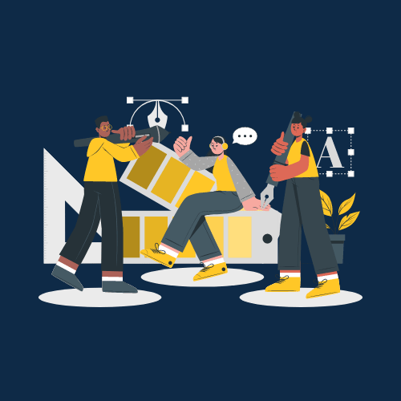

Storyset
Create your Story with our illustrated concepts. Choose the style you like the most, edit its colors, pick the background and layers you want to show and bring them to life with the animator panel! It will boost your presentation. Check out How it Works.
Pana
Amico
Bro
Rafiki
Cuate

Slide 35
Use our editable graphic resources...
You can easily resize these resources without losing quality. To change the color, just ungroup the resource and click on the object you want to change. Then, click on the paint bucket and select the color you want. Group the resource again when you’re done. You can also look for more infographics on Slidesgo.

Slide 38
JANUARY
FEBRUARY
MARCH
APRIL
MAY
JUNE
PHASE 1
Task 1
Task 2
PHASE 2
Task 1
Task 2
JANUARY
FEBRUARY
MARCH
APRIL
PHASE 1
Task 1
Task 2

Slide 41
...and our sets of editable icons
You can resize these icons without losing quality.
You can change the stroke and fill color; just select the icon and click on the paint bucket/pen.
In Google Slides, you can also use Flaticon’s extension, allowing you to customize and add even more icons.

Slide 42
Educational Icons
Medical Icons

Slide 43
Business Icons
Teamwork Icons

Slide 44
Help & Support Icons
Avatar Icons

Slide 45
Creative Process Icons
Performing Arts Icons

Slide 46
Nature Icons

Slide 47
SEO & Marketing Icons

